Slide 1
Topic
Topic
ChatGPT
ChatGPT
By Raushan Kumar

Slide 2


What is ChatGPT
ChatGPT is a cutting-edge language model developed by OpenAI, a renowned artificial intelligence research company. This remarkable technology has captivated the public's imagination, offering a glimpse into the transformative potential of AI-powered language understanding and generation. With its ability to engage in natural conversations, provide detailed information, and even tackle complex tasks, ChatGPT represents a significant stride forward in the field of natural language processing.

Slide 3
The Science Behind ChatGPT
Powering the Model
Machine Learning Principles
Computational Power
At the heart of ChatGPT lies a large language model, trained on a vast corpus of text data from the internet. This model, known as a Transformer, is a deep learning architecture that excels at understanding and generating human-like text. The model's ability to capture the nuances of language, context, and meaning is what enables it to engage in such remarkably human-like conversations.
Powering this remarkable technology is a significant amount of computational power, provided by advanced hardware and efficient algorithms. The training and deployment of ChatGPT requires substantial resources, including powerful GPUs and efficient data processing pipelines, enabling the model to handle the complexities of natural language interaction.
ChatGPT is built upon the principles of machine learning, where the model is trained on large datasets and learns to identify patterns and relationships within the data. This allows the model to generate coherent and contextually appropriate responses, drawing upon its deep understanding of language and the world.

Slide 4
Capabilities and Applications of ChatGPT
1
Natural Language Processing
2
Knowledge Synthesis
ChatGPT's primary strength lies in its ability to understand and generate human-like text. This allows it to engage in natural conversations, answer questions, and even assist with writing and research tasks.
By drawing upon its vast knowledge base, ChatGPT can synthesize information from multiple sources, providing detailed and well-informed responses on a wide range of topics. This makes it a valuable resource for research, education, and knowledge-sharing.
3
Task Assistance
4
Personalized Experiences
In addition to its conversational abilities, ChatGPT can also assist with a variety of tasks, such as brainstorming ideas, proofreading and editing text, and even generating creative content, like short stories or poetry.
Through its ability to understand context and tailor its responses accordingly, ChatGPT can provide personalized experiences for users, making it a valuable tool for customer service, education, and personal assistance.

Slide 5
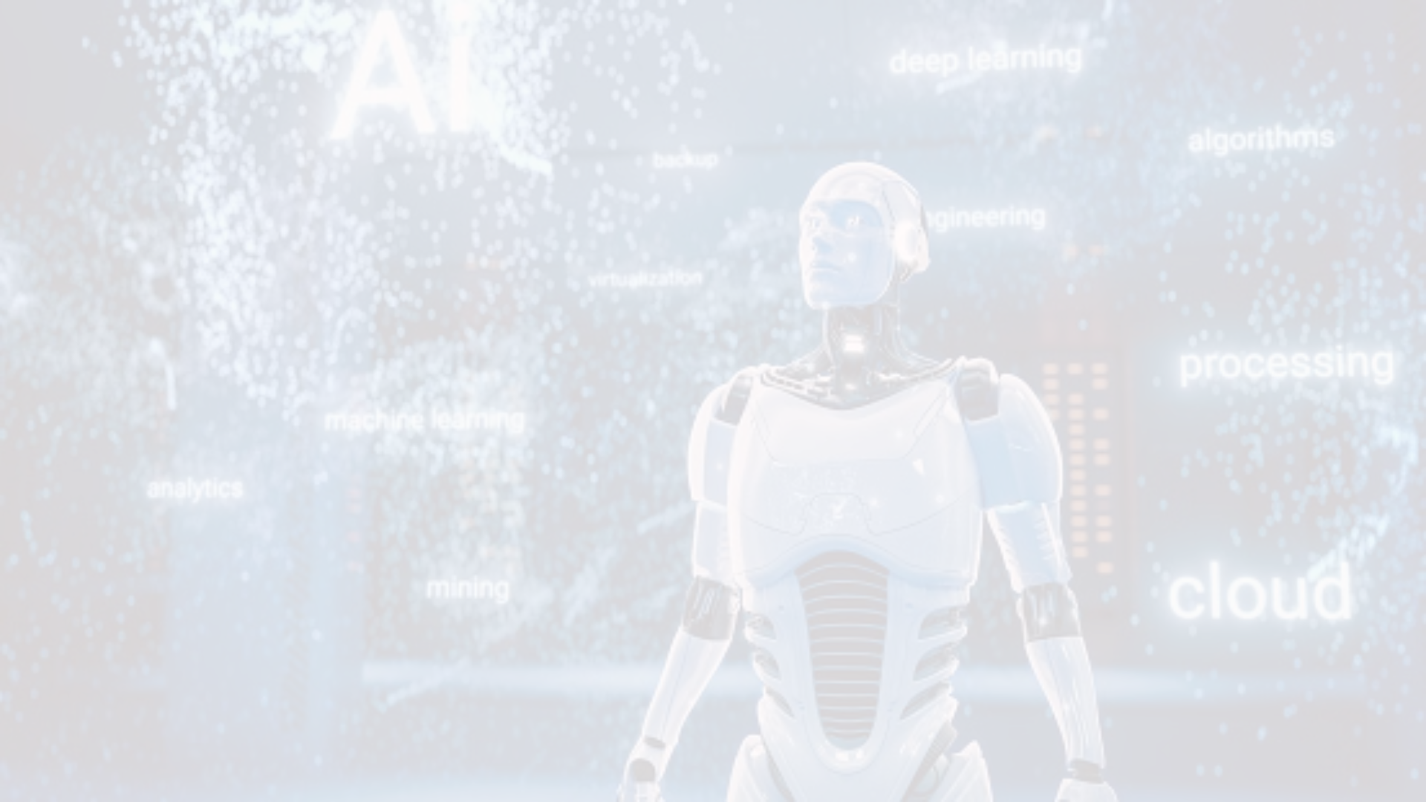



The Future of ChatGPT and AI Language Models
Continued Advancements
Expanded Applications
Ethical Considerations
The potential applications of ChatGPT and similar language models are vast, spanning fields like education, healthcare, customer service, content creation, and even scientific research. As these models become more capable and accessible, they will likely become an integral part of our daily lives, transforming the way we interact with technology and access information.
As the capabilities of AI language models grow, it will be crucial to address the ethical implications of their use, such as concerns around bias, privacy, and the potential for misuse. Responsible development and deployment of these technologies will be essential to ensure they benefit humanity as a whole.
As AI technology continues to evolve, we can expect to see further advancements in language models like ChatGPT, with improved natural language understanding, enhanced reasoning capabilities, and even multimodal integration, where the model can process and generate not just text, but also images, audio, and video.

Slide 6
Exploring the Limits of ChatGPT
Contextual Understanding
Knowledge Gaps
While ChatGPT is remarkably adept at understanding and generating human-like text, it still has limitations in its ability to fully comprehend the nuances of context and subtext. Ongoing research in areas like commonsense reasoning and multi-modal understanding may help to address these limitations.
As a language model, ChatGPT's knowledge is ultimately limited to the data it was trained on. While its knowledge base is extensive, there will always be gaps, particularly in rapidly evolving fields or niche topics. Users should be aware of these limitations and not treat ChatGPT as an infallible source of information.
Potential for Misuse
Ongoing Refinement
Like any powerful technology, ChatGPT and similar AI language models have the potential to be misused, such as for the generation of misinformation, plagiarism, or even malicious content. Responsible development and deployment of these technologies, along with user education, will be crucial to mitigate these risks.
As with any emerging technology, ChatGPT and other AI language models will continue to be refined and improved over time. Ongoing research, testing, and feedback from users will be critical to addressing the model's limitations and ensuring it remains a reliable and trustworthy tool.

Slide 7




The Societal Impact of ChatGPT
Education
Business
Creativity
Accessibility
ChatGPT's ability to assist with research, writing, and even tutoring tasks has the potential to revolutionize education, providing students with a powerful tool for learning and exploration.
In the business world, ChatGPT can enhance productivity, customer service, and content creation, helping organizations to streamline their operations and better serve their clients.
By assisting with ideation, writing, and even artistic tasks, ChatGPT can unlock new levels of creativity, empowering individuals and teams to push the boundaries of what's possible.
ChatGPT's ability to understand and communicate in natural language can make information and services more accessible to a wider range of users, including those with disabilities or language barriers.

Slide 8

Ensuring Responsible AI Development
1
Transparency
Developers of AI language models like ChatGPT must prioritize transparency, openly sharing information about the model's capabilities, limitations, and underlying processes. This will build trust and enable users to make informed decisions.
2
Ethical Guardrails
Rigorous ethical frameworks must be put in place to ensure AI systems are developed and deployed in a responsible manner, mitigating the risks of bias, privacy violations, and other potential harms.
3
Ongoing Evaluation
Continuous testing, monitoring, and evaluation of AI language models are essential to identify and address emerging issues, such as the generation of misinformation or inappropriate content.

Slide 9
Embracing the Future with ChatGPT
Empowerment
ChatGPT and similar AI language models have the potential to empower individuals, organizations, and society as a whole, by augmenting human capabilities and enabling new forms of creativity, productivity, and problem-solving.
Collaboration
As AI and humans work together, we can expect to see new modes of collaboration, where the strengths of both are leveraged to tackle complex challenges and drive innovation.
Ethical Responsibility
Ensuring the responsible development and deployment of AI language models will be crucial to mitigate risks and ensure these technologies benefit humanity as a whole.
Continuous Evolution
The field of AI language models is rapidly evolving, and we can expect to see continued advancements, with increasingly sophisticated capabilities and applications.

Slide 10
Embracing the Future with ChatGPT
Empowering Individuals
Transforming Organizations
Benefiting Society
ChatGPT and similar AI language models have the potential to empower individuals by augmenting human capabilities, enabling new forms of creativity, productivity, and problem-solving. This could lead to increased accessibility to information, personalized learning experiences, and enhanced self-expression.
On a broader scale, the responsible development and deployment of AI language models like ChatGPT can have a positive impact on society. These technologies have the potential to enhance education, improve accessibility, and tackle complex global challenges, ultimately leading to a more informed, inclusive, and prosperous future.
In the business world, ChatGPT can help organizations streamline operations, improve customer service, and drive innovation. By automating repetitive tasks and assisting with content creation and decision-making, AI language models can free up employees to focus on higher-level, strategic work.

Slide 11
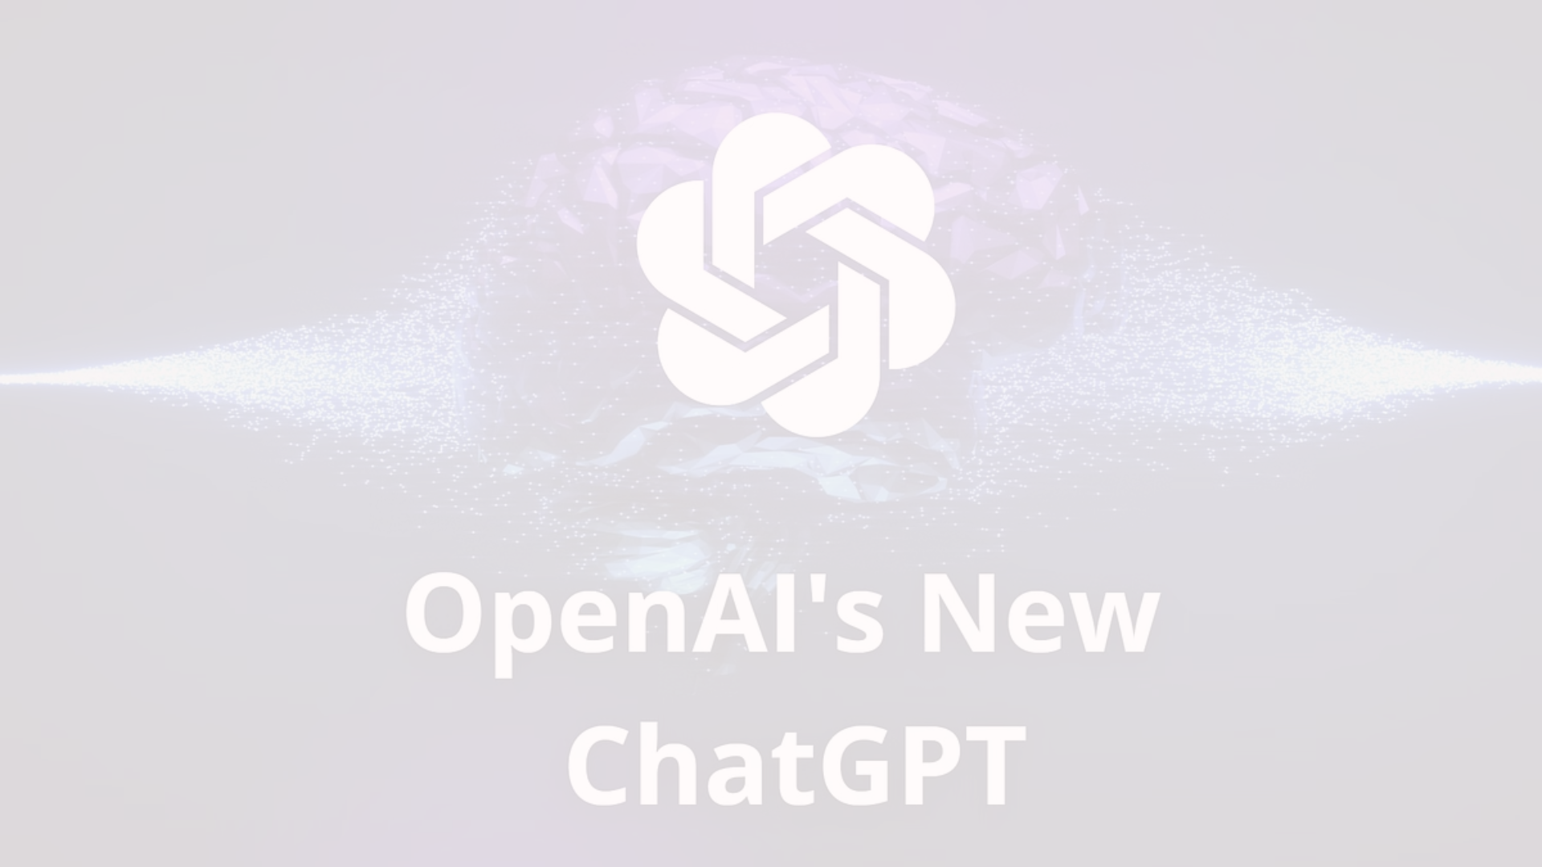
Embracing the Future with ChatGPT
Current Capabilities
Responsible Development
ChatGPT and similar AI language models have already demonstrated remarkable capabilities in areas such as natural language processing, knowledge synthesis, and task assistance. These models are transforming the way we interact with technology and access information.
Ensuring the responsible development and deployment of AI language models will be crucial to mitigate risks and ensure these technologies benefit humanity as a whole. This will require ongoing efforts in areas such as transparency, ethical guardrails, and continuous evaluation.
1
2
3
Ongoing Advancements
As AI technology continues to evolve, we can expect to see further advancements in language models, with improved natural language understanding, enhanced reasoning capabilities, and even multimodal integration, where the model can process and generate not just text, but also images, audio, and video.

Slide 12
Thank You

